Slide 1
Early Notification Scheme and HSIB
Programme update
10 June 2021
Annette Anderson - Head of Early Notification Team (Clinical) – NHS Resolution
Sangita Bodalia - Head of Early Notification Team (Legal) – NHS Resolution
Sian Brown - Early Notification Case Manager (Secondee)- NHS Resolution
Lorraine Cardill - Safety and Learning Lead (Midlands and East)- NHS Resolution
Elita Mazzocchi - Maternity Incentive Scheme Clinical Lead – NHS Resolution
Lisa Manning - Regional Lead for Maternity Investigations (Midlands and East) - HSIB

Slide 2
Content – overview of session
Introduction and overview of session by NHS Resolution
Overview of HSIB Maternity Investigations
NHS Resolution’s recent changes to the Early Notification Scheme process
Maternity Incentive Scheme update
Q&A session
Notes:
Host

Slide 3
Housekeeping
Please put yourself on mute
Please have your camera off. The speaker and presentation will be spotlighted for you to see.
Please type comments/questions in the chat function that you may have for the speaker/s
Notes:
Host

Slide 4
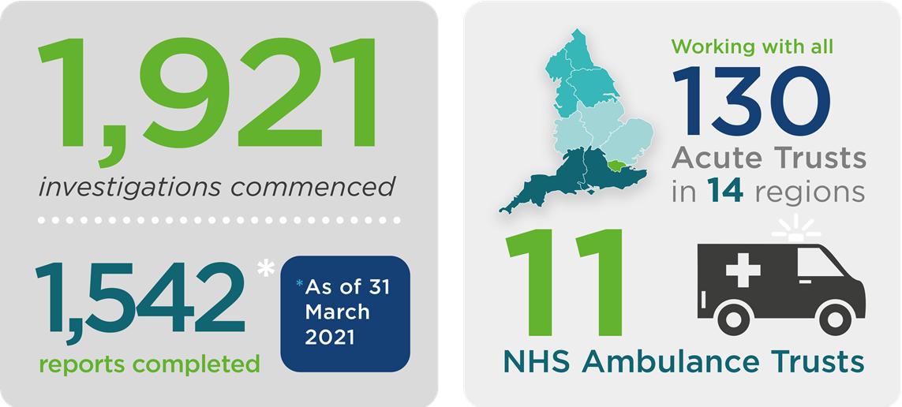
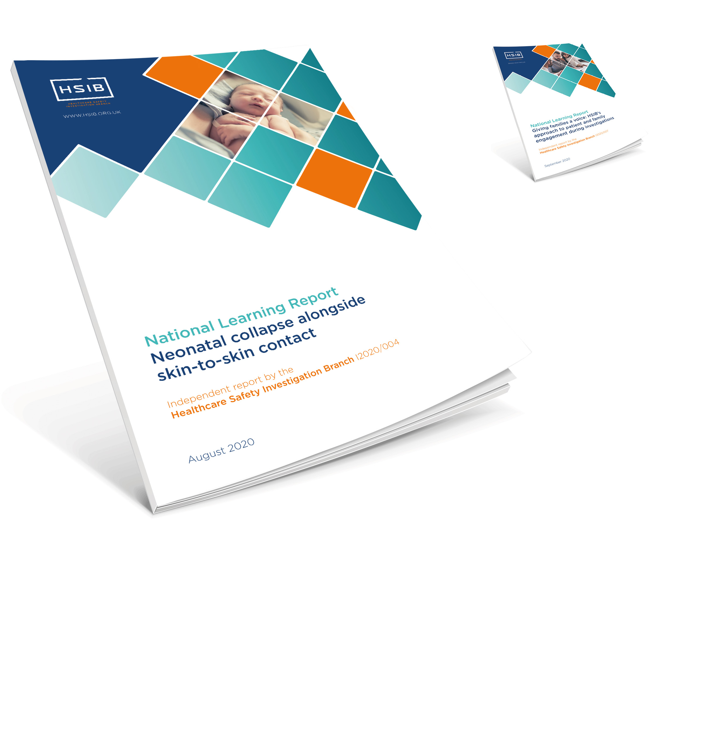
Maternity investigations
Recent publications:
Notes:
HSIB

Slide 5
Investigation criteria
HSIB undertakes maternity investigations in accordance with a defined criteria:
Intrapartum stillbirth: where the baby was thought to be alive at the start of labour and was born with no signs of life
Early neonatal death: when the baby died within the first week of life (0-6) days of any cause
*Severe brain injury diagnosed in the first 7 days of life, when the baby was diagnosed with grade III hypoxic ischaemic encephalopathy (HIE) OR was therapeutically cooled (active cooling only) OR had decreased central tone AND was comatose AND had seizures of any kind
Maternal death: death of a mother while pregnant or within 42 days of the end of the pregnancy, from any cause related to or aggravated by the pregnancy or its management, and not from accidental or incidental causes.
*referral details shared with NHS Resolution
Notes:
HSIB

Slide 6
HSIB criteria – Covid-19
HSIB no longer routinely investigate all maternity events involving cooled babies where there is no apparent neurological injury confirmed following therapy
Trusts are required to continue to refer all cases* as per the criteria in the HSIB Directions 2018
HSIB will triage these and in addition to those where harm has been confirmed , we will also investigate events where a family or trust have specific concerns
At the beginning of the pandemic, HSIB met with NHS Resolution to discuss reducing the burden on maternity services.
From Wednesday 1 April 2020, HSIB has been the notification portal for trusts for all cases meeting the criteria for HSIB and the NHS Resolution Early Notification Scheme
*all incidents should be referred to the HSIB portal with minimal information until consent can be established
Notes:
HSIB

Slide 7
HSIB and NHS Resolution working together
HSIB share the details of all referrals relating to severe brain injury with NHS Resolution via a monthly report
In addition we share details of cases that are rejected due to family consent where neurological damage was suspected or confirmed prior to rejection
Cases rejected due to family consent where we are unable to assess harm
On-going communication between HSIB/NHS Resolution
Monthly joint meetings
Weekly catch-up calls
HSIB share the final investigation report with NHS Resolution
Medical records, interview recordings and interview notes are not shared. If staff require a copy of their interview recording and or notes, please email: sar@hsib.org.uk
Notes:
HSIB

Slide 8
HSIB - Future and ongoing work
Publication of:
HSIB maternity investigations programme yearly review 2020/21: June
Intrapartum stillbirths during Covid-19: anticipated publication July
Suitability of equipment technology and tools used for fetal heart rate monitoring: anticipated publication June
Ongoing work with Trusts to support sharing of learning
Quarterly review meetings
Newsletter to share learning
Re-engagement with trust risk teams
Notes:
HSIB

Slide 9
Our role – getting closer to the incident
Past
EN involvement
Current
Source: Five years of cerebral palsy claims: a thematic review of NHS Resolution data
Notes:
Legal case manager

Slide 10
EN process up to Tuesday 31 March 2020
Notes:
Legal case manager

Slide 11
HSIB and EN (changes in reporting)
Saturday 1 April 2017 – Tuesday 31 March 2020
Trusts reporting all EN criteria cases to NHS Resolution
Wednesday 1 April 2020 – Wednesday 31 March 2021
Covid-19 period - trusts reporting all EN criteria cases to HSIB only
HSIB share datasets and completed investigation reports directly with NHS Resolution
Thursday 1 April 2021 onwards
NHS Resolution - No steps will be taken to investigate eligibility for compensation until HSIB has completed a safety investigation**
Outstanding cases from 2019/2020 to be reported to NHS Resolution via Claims Wizard
Trusts reporting all EN criteria cases to HSIB
NHS Resolution investigated all cases meeting criteria*
HSIB no longer routinely investigate all maternity events involving cooled babies where there is no apparent neurological injury confirmed following therapy
NHS Resolution brain injury definition narrowed – “Babies who have an abnormal MRI scan where there is evidence of changes in relation to intrapartum hypoxic ischaemic encephalopathy”
Notes:
Legal case manager

Slide 12
EN and HSIB process from 1 April 2021
Notes:
Legal case manager - Invite questions from Trust on new process at end of session

Slide 13
Improvements to EN Scheme – from April 2021
No steps will be taken to investigate eligibility for compensation until HSIB has completed a learning investigation (this means NHS Resolution will overlay liability investigation over the learning investigation)
The criteria for an investigation by NHS Resolution will be narrowed to those cases where there is evidence of changes in relation to intrapartum hypoxic ischaemic encephalopathy (HIE)
NHS Resolution to write to families directly - babies born after 1 April 2021
Continued feedback of learning points directly to trusts where improvement required
Continued contribution across wider maternity system
Notes:
Legal case manager

Slide 14
Clinical definition of brain injury
“Babies who have an abnormal MRI scan where there is evidence of changes in relation to intrapartum hypoxic ischaemic encephalopathy (HIE)”
Babies whose MRI findings fall outside of the clinical definition of a brain injury could still be accepted by the EN Scheme
For these babies, a multidisciplinary clinical review will take place to understand the extent of the MRI changes
If necessary, further information may be sought from the trust to help us decide whether an investigation into compensation entitlement should proceed
Notes:
Clinical case manager

Slide 15
Categorisation of existing cases
Review by NHS Resolution’s specialist clinical team to decide whether:
there is clinical evidence of a hypoxic brain injury that could potentially result in compensation; and
if so, whether there are any concerns about the care provided to the mother and baby which may have impacted on the outcome
Letter to trusts with intended action on EN cohort
Notes:
Clinical case manager

Slide 16
Early Notification Scheme - updates
First EN Report published in September 2019
outlined 6 key recommendations: candour, staff support, fetal monitoring, impacted fetal head, maternal deterioration and hyponatraemia
24 admissions recorded since the scheme started, this has now increased to over 140 admissions (includes breach of duty admissions only)
Second EN Report – due for publication later in 2021 – to include review and progress of recommendations, data, thematic review and further actions
Liability Protocol pilot (expert summit process) complete – to be reviewed and made permanent once improvements identified and actioned
Maternity Voices Group – EN collaboration with patient facing organisations/families
Notes:
Clinical case manager

Slide 17
Resources and Support
Dedicated web pages - https://resolution.nhs.uk/services/claims-management/clinical-schemes/clinical-negligence-scheme-for-trusts/early-notification-scheme/
Year one Early Notification Scheme report - https://resolution.nhs.uk/resources/early-notification-scheme-progress-report/
Early Notification Scheme case stories - https://resolution.nhs.uk/resources/?fwp_resources_type=case-story
Support for Trusts including feedback on EN cases
Notes:
Clinical Case Manager

Slide 18
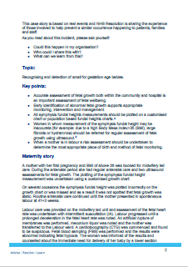
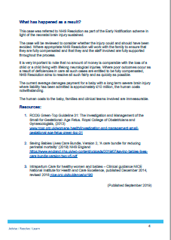
Case Stories
Notes:
Clinical case manager

Slide 19
The Maternity Incentive Scheme (MIS)
Uses the Clinical Negligence Scheme for Trusts (CNST) contribution for maternity as an incentive to implement the actions from maternity transformation board - work stream 2 safety group
A driver to improve safety in maternity and contribute to national ‘halve it’ campaign in stillbirth, neonatal and brain injury
NHS Resolution administers the scheme on behalf of Secretary of State for Health and Social Care
Two national maternity champions agree the ten actions developed by members of Collaborative Advisory Group
Notes:
Elita

Slide 20
Maternity Incentive Scheme
Notes:
Elita

Slide 21
MIS - Revised Safety Action 10
Have you reported 100% of qualifying cases to HSIB and (for 2019/20 births only) reported to NHS Resolution's EN Scheme?
Notes:
Elita

Slide 22
Safety Action 10, EN/HSIB reporting
Subject to external verification
Cross-check cases against the National Neonatal Research Database (NNRD) and HSIB data
Follow up outstanding cases

Slide 23
MIS year three
Thursday 1 October 2020 - MIS year three relaunched
Covid-19 continuing to present significant challenges to the NHS
Wednesday 25 November 2020 - MIS Collaborative Advisory Group (CAG) and safety action leads met to discuss options
CAG agreed to continue with year three of the scheme, but extend time for trust declarations until July 2021. Some of the safety actions were revised
Further support provided to trusts in January and March 2021, especially in relation to safety actions 2 and 8
Notes:
Elita

Slide 24
Communication with families
Statutory duty of candour remains with trust
Trusts to inform families of all investigations into their care
Trusts to continue with their initial 72 hour review reports
Progressed HSIB investigations required to be reported as Serious Incident (SI framework)
Dedicated web pages:
NHS Resolution - NHS trusts or member organisations and for patients, families or carers
HSIB - HSIB family engagement page
Notes:
EN Case manager

Slide 25
Proposed wording for Trusts
“We will also work with an NHS organisation called NHS Resolution to decide whether to proceed with a further review of the care provided, as part of NHS Resolution’s Early Notification Scheme. If you would like to know more about the Early Notification Scheme, please visit NHS Resolution’s website https://resolution.nhs.uk/services/claims-management/clinical-schemes/clinical-negligence-scheme-for-trusts/early-notification-scheme/support-for-patients-families-or-carers/”
This notification should form part of the trust’s maternity candour process
Notes:
EN Case Manager

Slide 26
Questions and Answers
Notes:
Host

Slide 27
Thank you for listening
Early Notification team
ENTeam@resolution.nhs.uk
www.resolution.nhs.uk
@NHSResolution

