Slide 1







Add
Digital Innovation in Healthcare
5th November 2024
12.30 – 13.30
@NHSResolution

Slide 2

Agenda
Time | Item | Speaker
12:30 | Introduction to the session with the first Poll Question | Chair, Caroline Latham-Parker NHSR Associate Safety & Learning Lead
12:35 | Digital Innovation & Automation at Portsmouth Hospital | Charlotte Taphouse, Digital Transformation Lead for the Hampshire and Isle of Wight Local Maternity and Neonatal System. Josh Clift, Associate Director of Software Development and Transformation, Portsmouth Hospitals NHS Trust
13:00 | Legal Update | Ed Glasgow, Partner – Kennedys Majid Hassan, Partner – Capsticks LLP
13.10 | Being Fair 2 | Michelle Stafford, NHSR Head of Safety & Learning
13.20 | Expert Panel Discussion | Rob Wilson, Partner Clyde & Co LLP
13:29 | Close with the second and last Poll Question | Caroline Latham-Parker, NHSR Associate Safety & Learning Lead

Slide 3



Poll 1
When coming along to this webinar what appealed most about today’s presentations?
12:30 – 12:35
GET IN TOUCH
FOLLOW US
nhsr.safety@nhs.net
@NHSResolution
NHS Resolution

Slide 4

Housekeeping
This is event is being recorded.
Please use the chat box to submit any questions.
Feel free to share your innovations in the chat.
An online feedback link will be shared in the chat at the end and emailed after the webinar.

Slide 5
Learning Objective
Improving access to healthcare is an essential element of improved outcomes & patient safety, this webinar aims to provide an awareness of some of the innovation being used for digitalisation in health and the legal framework surrounding it’s use.
.

Slide 6
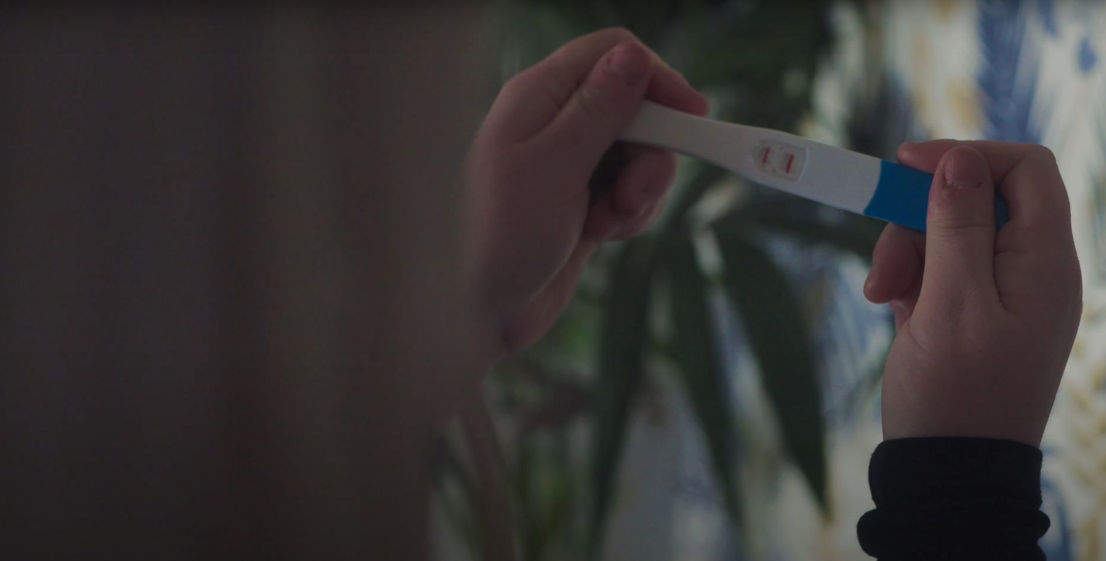


Maternity Intelligent Automation Programme
Josh Clift & Charlotte Taphouse

Slide 7

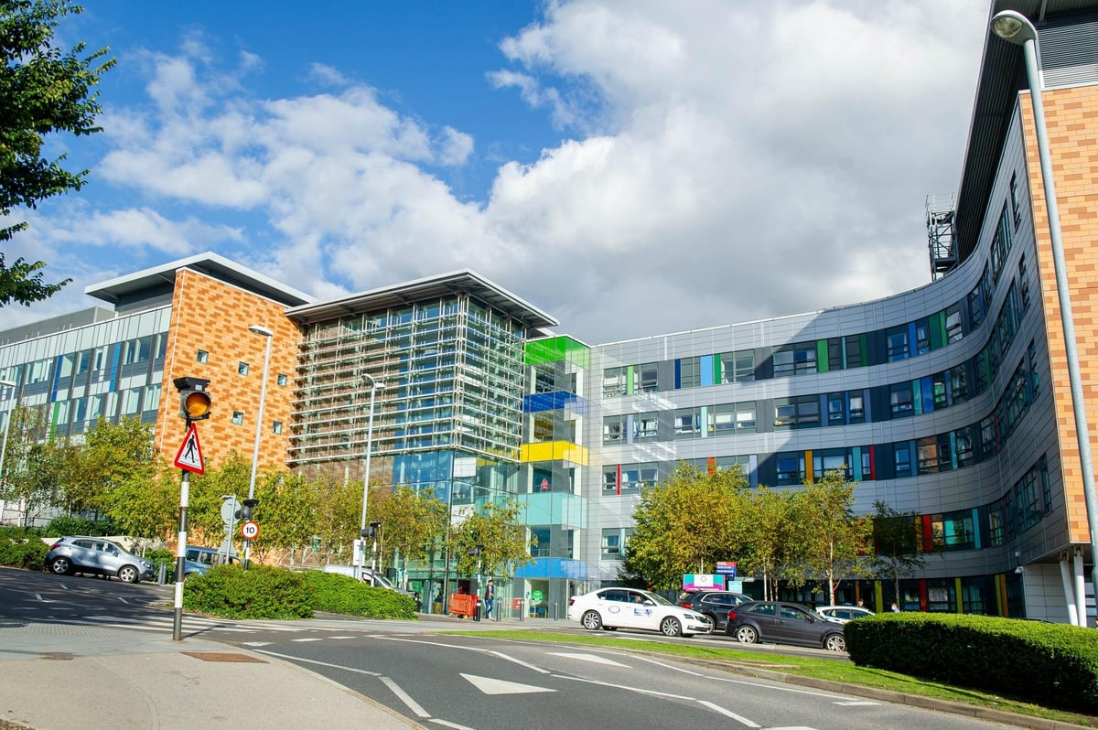
About Portsmouth Maternity Services
Large tertiary hospital on South coast of England
Covers population of 675,000
Maternity unit has 5,500 births per year
Maternity department went digital in 2021 with all Maternity services in Hampshire & IOW
Maternity Intelligent Automation programme commenced in 2022 to manages challenges that arose from the digital transformation

Slide 8

Our Digital Journey….
Live with full Maternity EPR February 2021 for all admissions and new bookings
Those booked on paper remained so until admission
Worked in a ‘hybrid’ model for 6 months
Excellent transition for clinicians (despite COVID-19 restrictions)

Slide 9
Clinical risks emerged as we transitioned from hybrid model to fully digital model
Increase in antenatal bookings >10 weeks gestation & large numbers >12 weeks
Increase referrals waiting to be actioned. Mailbox at its worst sat at around 2000-3000
Increase in missed screening opportunities due to late bookings and awaiting referrals
Digital system created an administrative burden

Slide 10

Our journey with PHU Innovation & Intelligent Automation team
Successful bid from the Unified Tech fund
Started work June 2022
Ambitious plans to what we can achieve
5 Key areas highlighted as areas of concern
MASSIVE amount of prep work
Maternity do so many things “that way” – just because that’s how we do it!!
Challenged learnt behaviours and rules

Slide 11
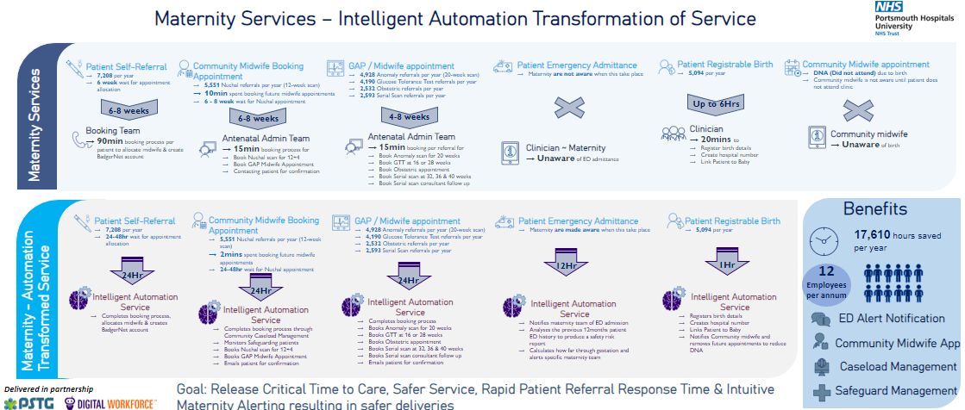
We launched an unprecedented innovation in a clinical setting

Slide 12
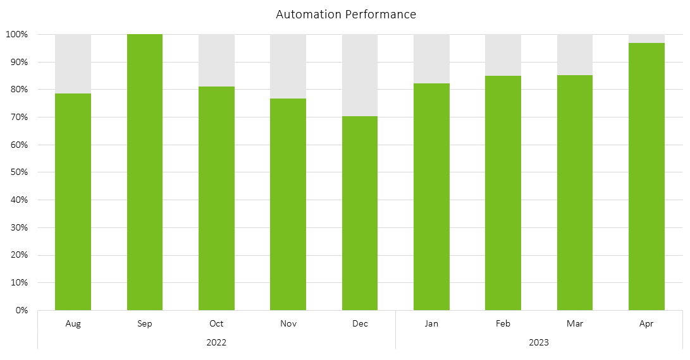
An example of our achievements
Automation turned on & in Apr-23 98% of scans were all booked within guidelines
Automation Performance
Since switch on, automation performance consistently hit 70% or above
Several enhancements have been made to increase performance
April 23 saw performance hit 98%
Process Improvements implemented for Automation
Less than 30% of scans were booked within guidelines

Slide 13
An example of our achievements

Slide 14
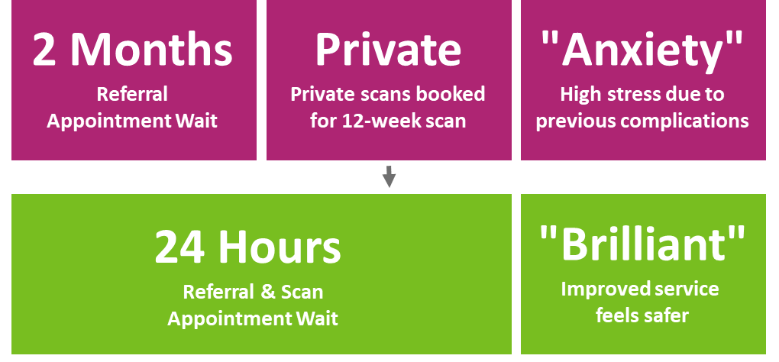
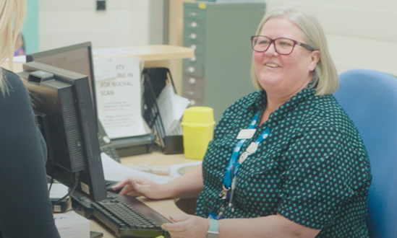
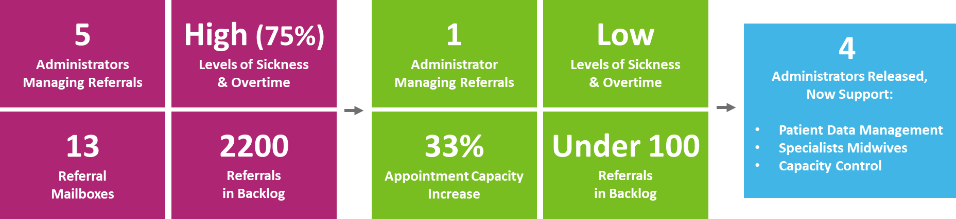
We’ve significantly improved patient & staff experience

Slide 15

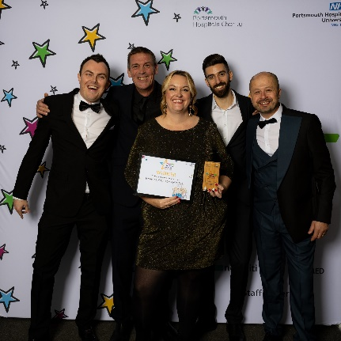
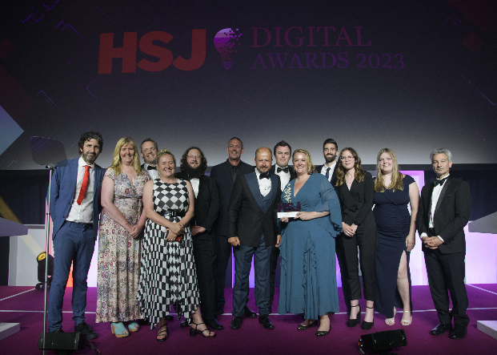
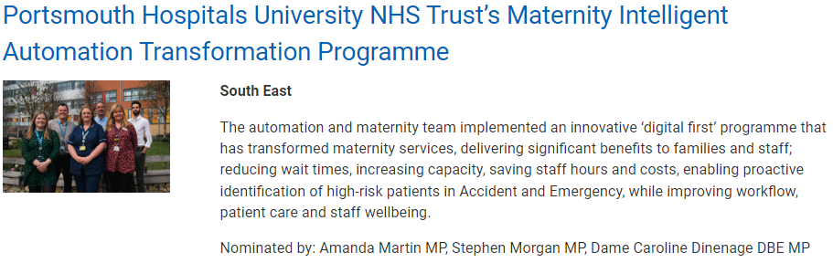



Commendations
Maternity Services Automation Transformation Success -
Portsmouth Hospital University Trust has achieved remarkable results with intelligent automation in maternity services. The service received a good rating from the CQC (Care Quality Commission) for the first time, and the CQC highlighted the technology contribution as outstanding. The team implemented solutions to enhance information management, appointment booking, and emergency department alerts.

Slide 16
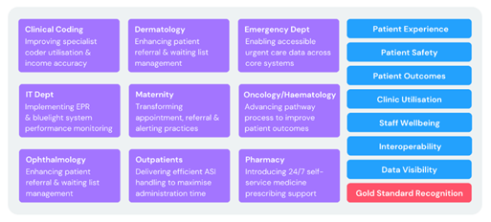
Impact of Intelligent Automation in PHU:
The Intelligent Automation team at PHU has become a leader in implementing solutions to transform clinical and administrative processes across various departments and specialties. The aims of these deliveries have been to improve patient experience, patient safety, patient outcomes, clinic utilisation, staff wellbeing, interoperability, and data visibility.
We have automated 22 processes by end of FY23/24 across Clinical Coding, Dermatology, Emergency Department, Maternity, Oncology, Haematology, Ophthalmology, Outpatients, and Pharmacy. These automations have reduced manual work, errors, delays, and costs, while increasing accuracy, speed, quality, and compliance. These automations are saving the trust 38 full-time equivalent staff members (WTEs) and a significant amount of releasing time to care (RTC).

Slide 17
Add
Legal Update
Ed Glasgow, Partner – Kennedys
Majid Hassan, Partner – Capsticks LLP
@NHSResolution

Slide 18
Digital Healthcare Technology
Adopting & Developing Platforms for Better Patient Care
Identifying Risk Type & Risk Impact
Governance to Mitigate & Control Risk
Future Healthcare
Defining Digital
Current Trends

Slide 19
Digital Healthcare Technology
1. Identifying Risk Type
1.1. Clinical Risks
1.2. Operational Risks
1.3. Data Security Risks
1.4. Financial Risks

Slide 20
Digital Healthcare Technology
2. Identifying Risk Impact
2.1. Engage Stakeholders
2.2. Review Past Experiences
2.3. Adopt Risk Assessment Tools

Slide 21

Harm resulting from clinician using an AI-enabled application – who is liable?
What about failing to use AI / ignoring results / not using it properly
Who is liable if product behaved in a way that wasn’t anticipated – developer or clinician
Non delegable duty of care to patient so what is contractual liability and indemnity
Product liability and “state of knowledge” defence in claims re medical devices
Risks with AI-Liability

Slide 22

Control – how does AI fit in with workflow and who is responsible for clinical decisions.
Dependence – over reliance on AI that may record or autofill the wrong drug being used
Disclosure – if vendors of AI provide risk and disclaimer information should clinicians protect themselves by passing on that information to the patient
Liability and malpractice risk

Slide 23

Will AI help achieve organisational goals?
Good governance via a suitably qualified committee
Consider an Innovation Management / AI Centre to work across the organisation, develop pilot studies, create data architecture, share success stories and scale up AI pilots
Data governance
Due diligence and contractual review
Evidence of training and implementation of protocols around AI
Integrating AI and managing risk

Slide 24

Being fair 2
Promoting a person-centred workplace that is compassionate, safe and fair
Michelle Stafford NHS Resolution
nhsr.safety@nhs.net
@NHSResolution
Advise / Resolve / Learn
Notes:
This webinar today focusing on AI in the workplace – these changes offer both opportunities and challenges for organisations and leaders – it centres around organisational learning and team work, Last year, NHSR published our Being fair 2 report which aims to promote the value of a person-centred workplace that is compassionate, safe and fair. We encourage everyone involved in the provision of healthcare to adopt these principles and ensure that staff are supported effectively and compassionately, this follows on from our original Being Fair report on a just and learning culture. Both reports emphasise the vital role leadership plays in achieving this.– and for successful AI integration there needs to be continuous learning, clear communication and robust training to maintain trust and foster growth. This really highlights the importance of good organisational culture with that central ;just and learning culture’ and compassionate leadership to enable change and improvement.

Slide 25
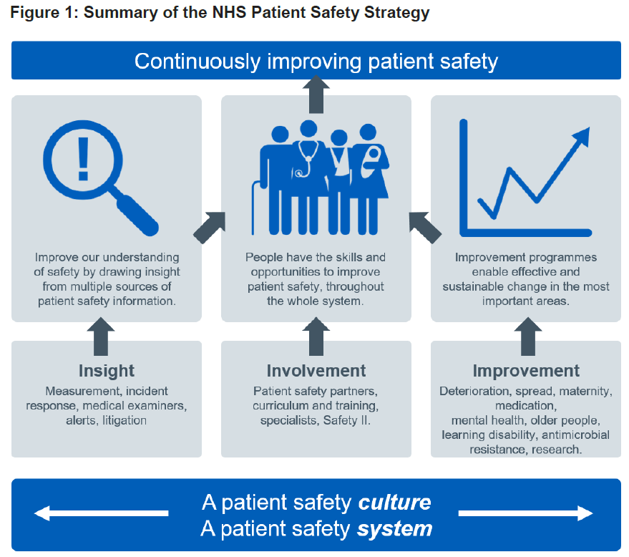

Patient safety strategy
Notes:
We know that there is a clear link between culture, workforce and patient safety. A poor culture is costly:
We know there is an association between staff experience and engagement, productivity, patient outcomes and safety. Focusing on insight, involvement (people having the skills and opportunities to improve patient safety) and improvement programmes to enable effective and sustainable change

Slide 26

Improving workplace culture
There is clear evidence that compassionate leadership results in more engaged and motivated staff with high levels of wellbeing, which in turn results in high quality care.
Notes:
Enabling change and implementation of new ways of working -
Change management is all about people. ...
Instil trust. ...
Shared vision. ...
Empower staff
Compassion and accountability Minimise penalties for making mistakes. ...
Learn from failure.

Slide 27











Just and learning culture charter
Notes:
We there invite Organisations to consider adopting the suggested ‘Just and learning culture charter’ in our Being Fair reports - and to use the invaluable resources signposted throughout the BF2 report. We know that organisational culture, is often invisible but is a potent force influencing behaviors and attitudes, and change readiness for integration of AI – We need to foster an environment of continuous learning and innovation – which needs all of the 10 facets in the charter shown here.

Slide 28
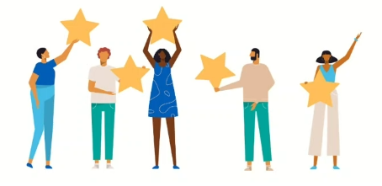
Thank you

Slide 29
Expert panel discussion
Lead - Rob Wilson
Partner Clyde & Co LLP
FOLLOW US
GET IN TOUCH
@NHSResolution
nhsr.safety@nhs.net
NHS Resolution

Slide 30
Expert Panel
Charlotte Taphouse - Digital Transformation Lead for the Hampshire and Isle of Wight Local Maternity and Neonatal System. Josh Clift - Associate Director of Software Development and Transformation, Portsmouth Hospitals NHS Trust Ed Glasgow – Partner, Kennedys Majid Hassan - Partner, Capsticks LLP

Slide 31
Poll 2
What did you gain from today’s forum and what are you taking away from today?
FOLLOW US
GET IN TOUCH
@NHSResolution
nhsr.safety@nhs.net
NHS Resolution

Slide 32

Thank you!
We hope you have found this event useful, please remember complete this short survey here to help us with future events
FOLLOW US
GET IN TOUCH
SCAN ME
@NHSResolution
nhsr.safety@nhs.net
NHS Resolution
https://www.smartsurveys.co.uk/s/2FUJWE/

