Slide 1






^{North West NHS primary care}
Dispelling the myth-towards safer practice
Webinar one: Seeking support for claims
^{Wednesday 10th April, 1pm-2pm}
Patricia Roe, Partner, Hempsons
Dr Anwar Khan, Senior Clinical advisor for General Practice, NHS Resolution
Andrea Leng, Operational team leader, NHS Resolution

Slide 2



Introduction
NHS Resolution is an arms length body of the Department of Health and Social Care and was established in 1995
We provide expertise to the NHS on resolving concerns and disputes fairly, sharing learning for improvement and preserving resources for patient care
We administer, on behalf of the Secretary of State for Health, indemnity schemes covering the legal liabilities of NHS organisations in England, independent sector providers of care to NHS patients, and the Department of Health
Our claims functions have been augmented over time and now include a wider responsibility to reduce harm and improve safety
The functions of two previously independent organisations now come under the NHS Resolution umbrella – Primary Care Appeals and Practitioner Performance Advice
Our strategy - NHS Resolution
Notes:
Good afternoon everyone
My name is Andrea Leng and I am an Operational Team Leader at NHSR
in the North West Region and have been at NHSR for over 2 years having previously worked in an acute Trust for over two decades in patient safety.
Introduction slide by NHS Resolution – This is the first in a series of four events to support primary care practitioners with safe practice & knowledge of the GP indemnity scheme

Slide 3
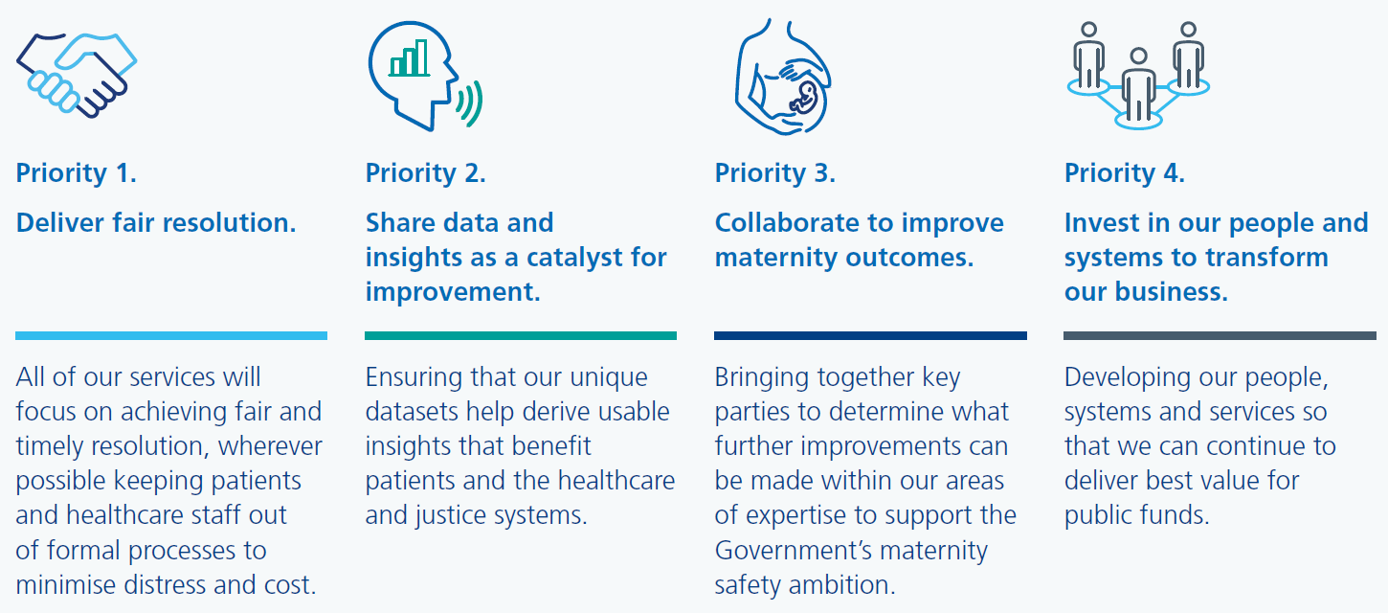
Our strategic priorities
Notes:
Deliver fair resolution: All of our services will focus on achieving fair and timely resolution, wherever possible keeping patients and healthcare staff out of formal processes to minimise distress and cost.
Data and insights: Ensuring that our unique datasets help derive usable insights that benefit patients and the healthcare and justice systems.
Maternity: We will build on our reputation as a trusted partner in the maternity healthcare system, bringing together key parties to see what more can be done to support the government’s maternity safety ambition to halve rates of stillbirth, neonatal and maternal death and brain injuries that occur during or shortly after birth by 2025.
People: The NHS is undergoing major restructuring while continuing to respond to and recover from the pandemic. We will develop our services to support this and have initiated two major change programmes to invest in our people, systems and services to continue delivering best value for public funds.

Slide 4
Introduction
North West Regional Team, NHS Resolution
North West 3 (GPI)
Operational Team Leader
Andrea Leng
Technical Leaders
Sam Berry
Lisa-Marie Musgrave
Senior Case Managers
Nicola Kehoe
Amy Steele
Glen Upton
Case Managers
Claire Allanson
Robert Chard
Rakinder Dosanjh
Alex Lee
Jessica Ridley
Notes:
Introduction slide by NHS Resolution – The first in a series of four events to support primary care practitioners with safe practice & knowledge of the GP indemnity scheme
There are three teams of claims handlers at NHS Resolution covering the North West region with Team 1 and 2 covering member Trusts clinical and non clinical claims. NHS Resolution will be the first port of call when a claim is notified or received
North West 3 provide support for General Practice Indemnity claims liaising with primary care practitioners, Practice Managers and associated staff to manage the investigation and resolution of clinical claims reported to us.
The team consists of an Operational Team Leader, Technical Leader, Senior Case Managers and Case Managers who are assigned cases for the North West area.
They may instruct a panel firm to assist – for claims in the North West that will usually be Hempsons, Hill Dickinson or Weightmans.
Hand over to Patricia Roe at Hempsons who is going to give overview of claims and how to seek support for them from NHS Resolution

Slide 5
What is a claim?
Duty of care
Breach of that duty
  Bolam
  Bolitho
Causation
Limitation
Quantum

Slide 6
The Practice has received a claim – now what?
General Practice Indemnity Schemes
Coverage for the schemes
  CNSGP
  ELSGP
Out of scope
Please visit:
https://resolution.nhs.uk/services/claims-management/clinical-schemes/clinical-negligence-scheme-for-general-practice/
Notes:
Two schemes
The Clinical Negligence Scheme for General Practice (CNSGP) - For certain primary care incidents that occurred on, or after, 1 April 2019.
The Existing Liabilities Scheme for General Practice (ELSGP) - For certain primary care incidents that occurred prior to 1 April 2019.
CNS GP – incident on / after 1.4.2019 / primary medical services and ancillary health services
Primary Medical Services are defined as NHS primary care delivered under Primary Care Contracts i.e. GMS, PMS or APMS contracts or where Schedule 2L of the NHS Standard Contract has been utilised.
Ancillary health services are defined as activities carried out in connection with the provision of other NHS services where the provider’s principal activity is to provide NHS primary medical services.
When creating the scheme, DHSC wanted it to cover all NHS Primary Care. This is why indemnity cover is not associated with individuals or roles, but with activities provided under appropriate contracting arrangements. This means that any new activities or roles which are created in NHS Primary Care, will still fall within the scope of CNSGP as long as they have been contracted in the right way
Coverage is automatic – no need to register – relates to the work not the individual.
Covers all those carrying out primary medical services
Some matters are not covered by CNSGP – complaints / GMC or other inquiries and investigations / inquests / disciplinary proceedings / awards made by the parliamentary health service ombudsman / private work
As a result, it is important to maintain medical defence organisation cover for those matters
ELSGP -
The eligible person was providing a service under a primary care contract (GMS, PMS or APMS (schedule 2 L)) or was providing an ancillary health service prior to 1 April 2019
The service was in connection with the care, diagnosis or treatment of the patient
The secretary of state for health has entered into a contractual arrangement with the medical defence organisation to provide indemnity for historical liabilities and legal ownership has been transferred – that means the person concerned must have been a member of MDDUS or MPS at the time of the incident
To determine whether NHSR can provide indemnity, a copy of the primary care contract in place at the time of the incident is required and details of MDDUS or MPS membership which our case managers will then utilise to verify there was membership at the time of the alleged incident.
Range of documentation available on the NHS Resolution website to assist including reminder of matters in scope

Slide 7
How and when to report a claim
Contact NHS Resolution where:
Patient safety incident
Claim indicated when disclosure of records requested
Letter of Claim / Letter of Notification / Claim form / Part 36 offer / any demand for compensation
Parliamentary Health Service Ombudsman correspondence
Complaint response which amounts to an admission of breach of duty
Any intended offer of compensation or other redress
Group Action
‘When and how to report a claim’ guidance on website for CNSGP and ELSGP
Notes:
Incident before AND after 1 April 2019 – report to MDO AND to NHS Resolution
Timescales in the guidance but ideally you should report as soon as possible and that is particularly the case with formal Court documents or a letter of claim as there are timescales involved

Slide 8
When and how to report a claim
By email:
  nhsr.cnsgpnotification@nhs.net
  nhsr.elsgpnotifications@nhs.net
By telephone:
  0800 030 6798
What is needed from you?
  Notification form
  Send relevant documents
  Provide contact details
  Help with enquiries
Support
Notes:
By email
- send the details of the enquiry without patient sensitive data – no documents should be sent in the first instance
By telephone
- this is a 24/7 helpline for CNSGP and ELSGP enquiries. It is supported by the panel firms so you will receive a callback – the panel firm will log the enquiry with NHS Resolution who will then be in touch
Sent a notification form which needs to be completed with as much detail as possible – that should be returned as soon as possible
Relevant documents – correspondence received, records, comments from the staff involved, any other relevant documents for example complaint
Contact details for a lead point of contact at the practice
You will need to have some input in the investigation – timely responses are welcomed – acknowledged these can be stressful situations but there are timescales which should be complied with. Those investigating potential claims and claims that become formal court processes need your assistance to provide the best possible support for you.
NHS Resolution and the panel firms are there to support you and others involved in claims. The day to day management of claims is dealt with by them – to allow you to focus on your clinical roles – but in order to provide the best possible support, timely responses are needed
GP indemnity beenficiary Cahrter – explains hwo NHS Resolution and the beneficiaries to the GP indemnity schemes will work together – help to clarify uncertainties caused during the life of a claim. Worth a read – available on the website

Slide 9
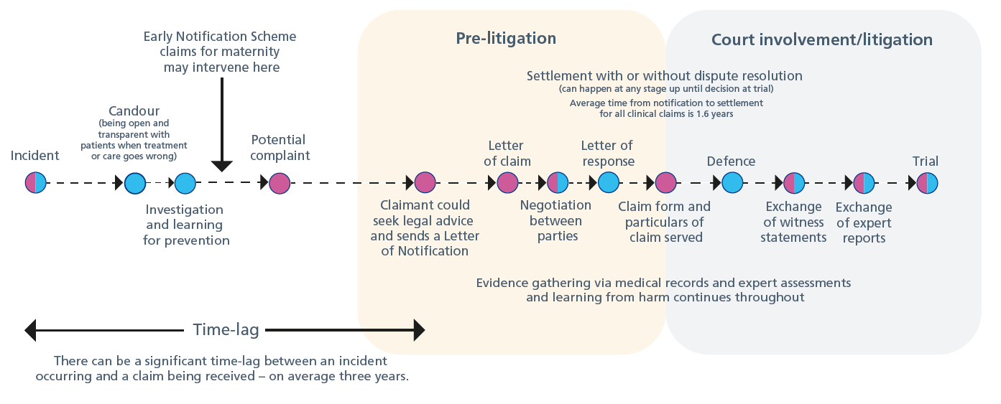
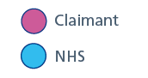
Life cycle of a claim
Notes:
Unfortunately claims can take a long time
Incident investigations can happen after a complaint – neither the patient nor the clinical staff involved may know that anything has gone wrong or that an injury has occurred until later. For that reason can be years (the average indicated here is three) before there is even notification
LoC and LOR – time frame is 4 months whilst that can be extended – ideal to respond within the timeframes
If Court proceedings are issued, time scales will be different for each case – a timetable will be set down by the Court - but from the receipt of formal proceedings can be 18 months to 2 years before a trial date is fixed
Those involved in the claim will likely have points during this life cycle when more involved – such as letter of response, defence, witness statement and trial if that is needed. Very few cases proceed to a trial – around 2% - claims are often resolved well before trial either by the Claimant not proceeding or the decision being made to resolve the claim. Your input would be needed for a decision to resolve a claim.

Slide 10
External factors
Covid
Fixed recoverable costs
Legislation
Notes:
Life cycle on the previous slide what is expected
Are external factors that can impact time scales and the management of claims
- Covid still impacting claims – are Covid claims coming through – direct / indirect
- Courts adversely impacted and some are still managing backlogs
FRC
- idea is to provide faster resolution in some cases and to keep costs proportionate
- may mean even tighter timescales for return of information
Other legislation – not aware of anything currently in the pipeline but Health Select Committee have in the past considered NHS Litigation reform and could be considered again in the future

Slide 11
Experiences
Let me tell you a little story………..
Notes:
Dr Anwar to provide comments
Questions

Slide 12

Questions
Notes:
Dr Anwar to provide comments
Questions

