Slide 1

NHS Resolution and our strategy
12 October 2023
Denise Chaffer
Director of Safety and Learning NHS Resolution

Slide 2
NHS Resolution purpose, functions and strategic focus:
Claims management
Practitioner Performance Advice
Our purpose is to provide expertise to the NHS to resolve concerns fairly, share learning for improvement and preserve resources for patient care.
Primary Care Appeals
Safety and Learning

Slide 3
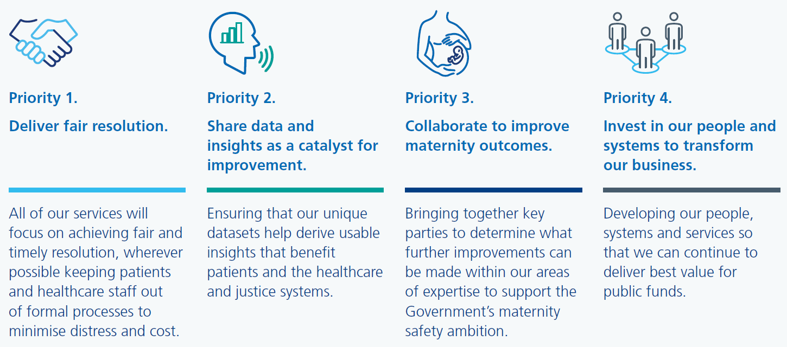
Our strategic priorities

Slide 4
NHS Resolution initiatives to improve response to harm
Response to harm – getting closer to the incident
Early Notification Scheme
  Findings
  Impact
  Preliminary evaluation – benefits
Maternity Incentive Scheme
  Curated safety actions
  Process
Prevention of harm – resources – thematic review reports – recommendation to implementation

Slide 5
What do people expect?
What do patients and families want?
  An apology
  To prevent it happening to someone else
  To understand what went wrong
  To have answers and be heard
  Compassion, understanding and support
  Signposting to support where appropriate
What do staff want?
  Help to say sorry
  To prevent it happening to someone else
  To understand what went wrong
  To have answers and be heard
  Compassion, understanding and support
  Signposting to support where appropriate

Slide 6

Saying sorry
Saying sorry meaningfully when things go wrong is vital for everyone involved in an incident, including the patient, their family, carers, and the staff that care for them.
Saying sorry is:
  always the right thing to do
  not an admission of liability
  an acknowledgement that something could have gone better
  the first step to learning from what happened and preventing it recurring

Slide 7

Duty of Candour
Duty of candour animation

Slide 8

Being fair: supporting a just and learning culture for staff and patients following incidents in the NHS
A just and learning culture is the balance of fairness, justice, learning – and taking responsibility for actions. It is not about seeking to blame the individuals involved when care in the NHS goes wrong. It is also not about an absence of responsibility and accountability.
All actions should be understood
Staff should be supported to learn from their actions
Chaffer, D., Kline, R. and Assame, N.

Slide 9


Being Fair 2
Being Fair 2

Slide 10
The Maternity Incentive Scheme
Uses the CNST contribution to incentivise implementation of initiatives recommended by system stakeholders to improve maternity care
Contribute to national ‘halve it’ campaign for stillbirth, neonatal and brain injury.
NHS Resolution administers the scheme on behalf of Secretary of State for Health and Social Care
Ten safety actions

Slide 11
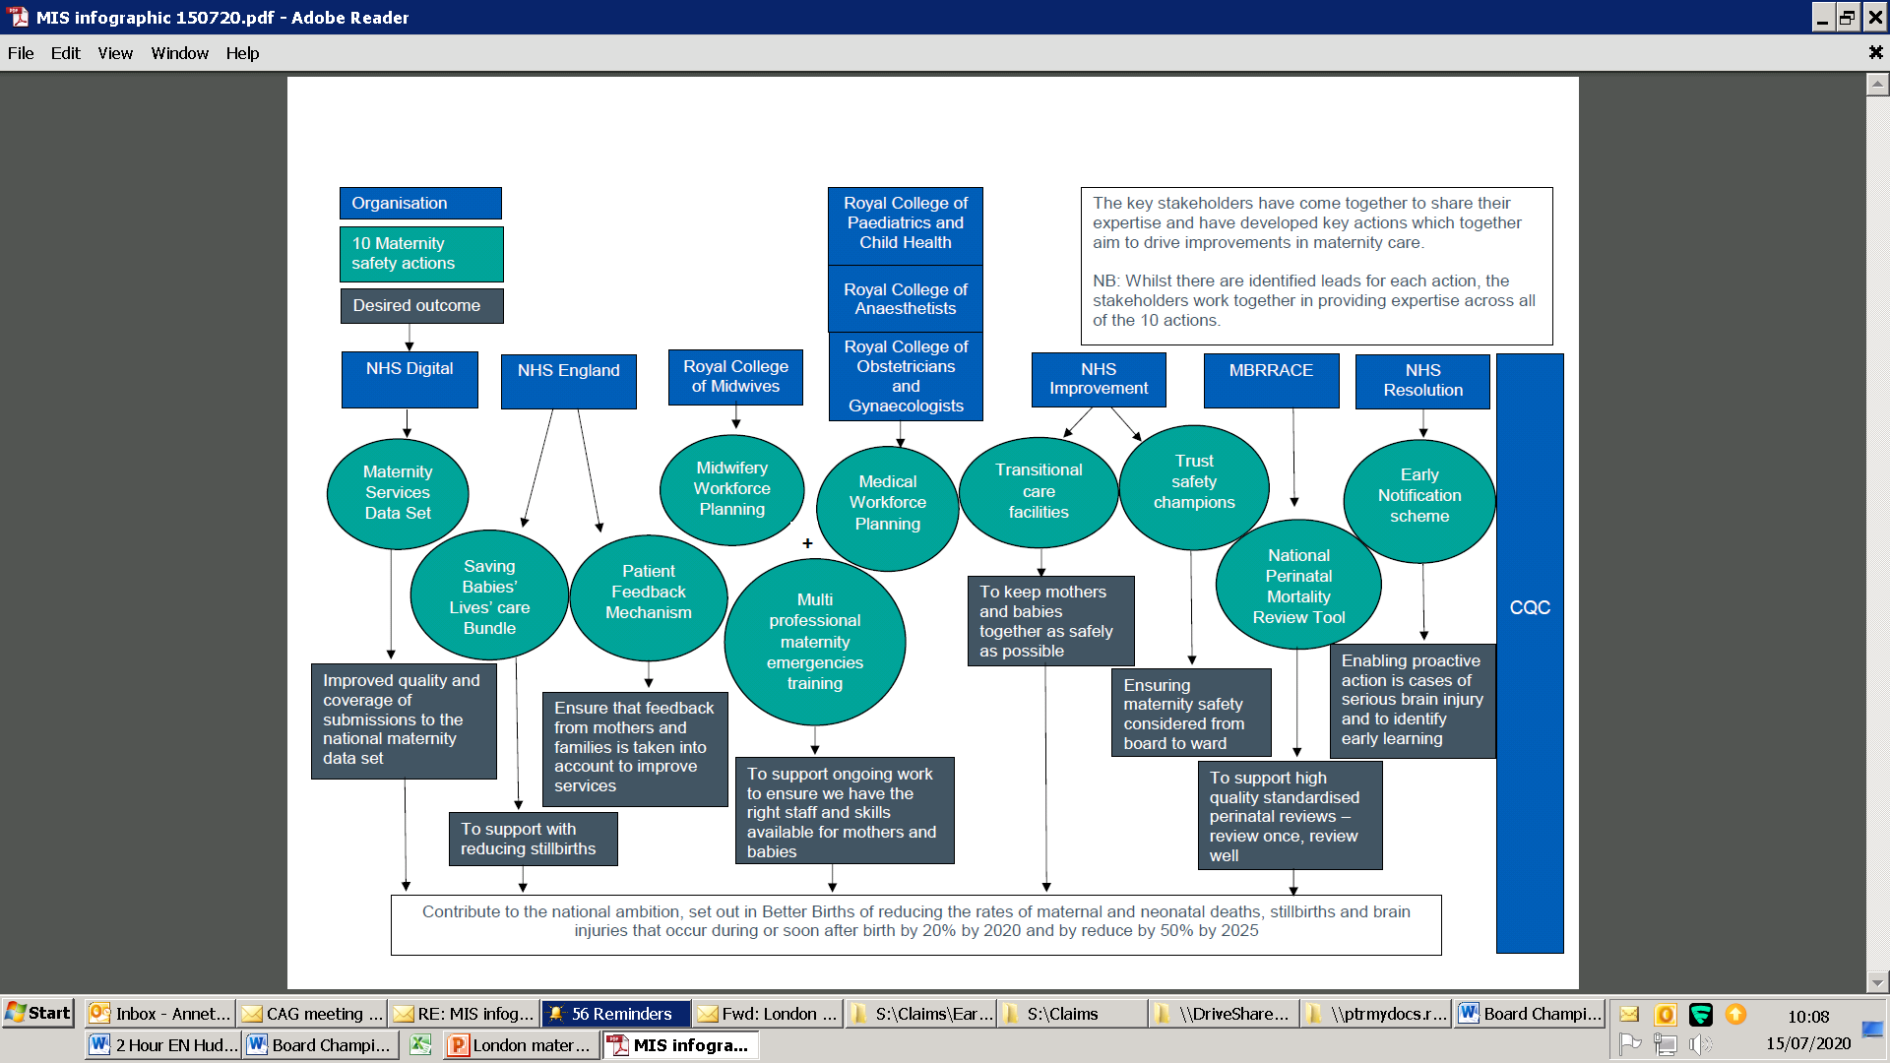
Maternity incentive scheme

Slide 12
MIS scheme conditions
Board assured that the evidence provided to demonstrate achievement of the ten maternity safety actions meets the required standards as set out in the safety actions and technical guidance document
Discussed with commissioner prior to submission of declaration
External verification points (safety action 1, 2 and 10)
CQC and MNSI sense check

Slide 13


The Early Notification Scheme: The investigation process
Sangita Bodalia CMgr MCMI
Head of Early Notification (Legal)
NHS Resolution
Jayne Poole RM
Safety and Learning Lead (Early Notification)
NHS Resolution

Slide 14

We will discuss
The EN Scheme and its aims
EN criteria and liability investigation process
The second report: The Evolution of the Early Notification Scheme
Questions and Answers

Slide 15
1. The EN Scheme and its aims

Slide 16
1. The Early Notification Scheme
Aims to provide a more rapid, caring response to families where a baby may have suffered severe harm.
Established in April 2017. Designed primarily to:
  Accelerate investigations into whether or not a baby is entitled to receive compensation, reducing the need for costly, formal processes where possible; and
  Help ensure that steps are taken to learn and sharing good practice.

Slide 17
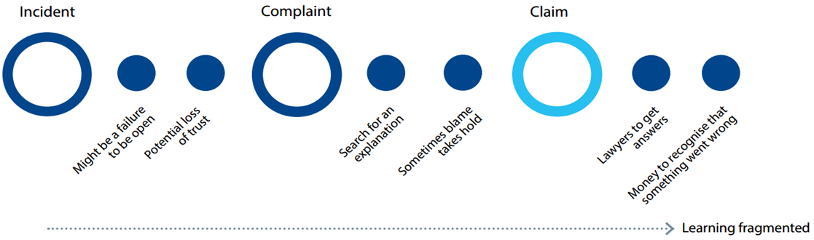
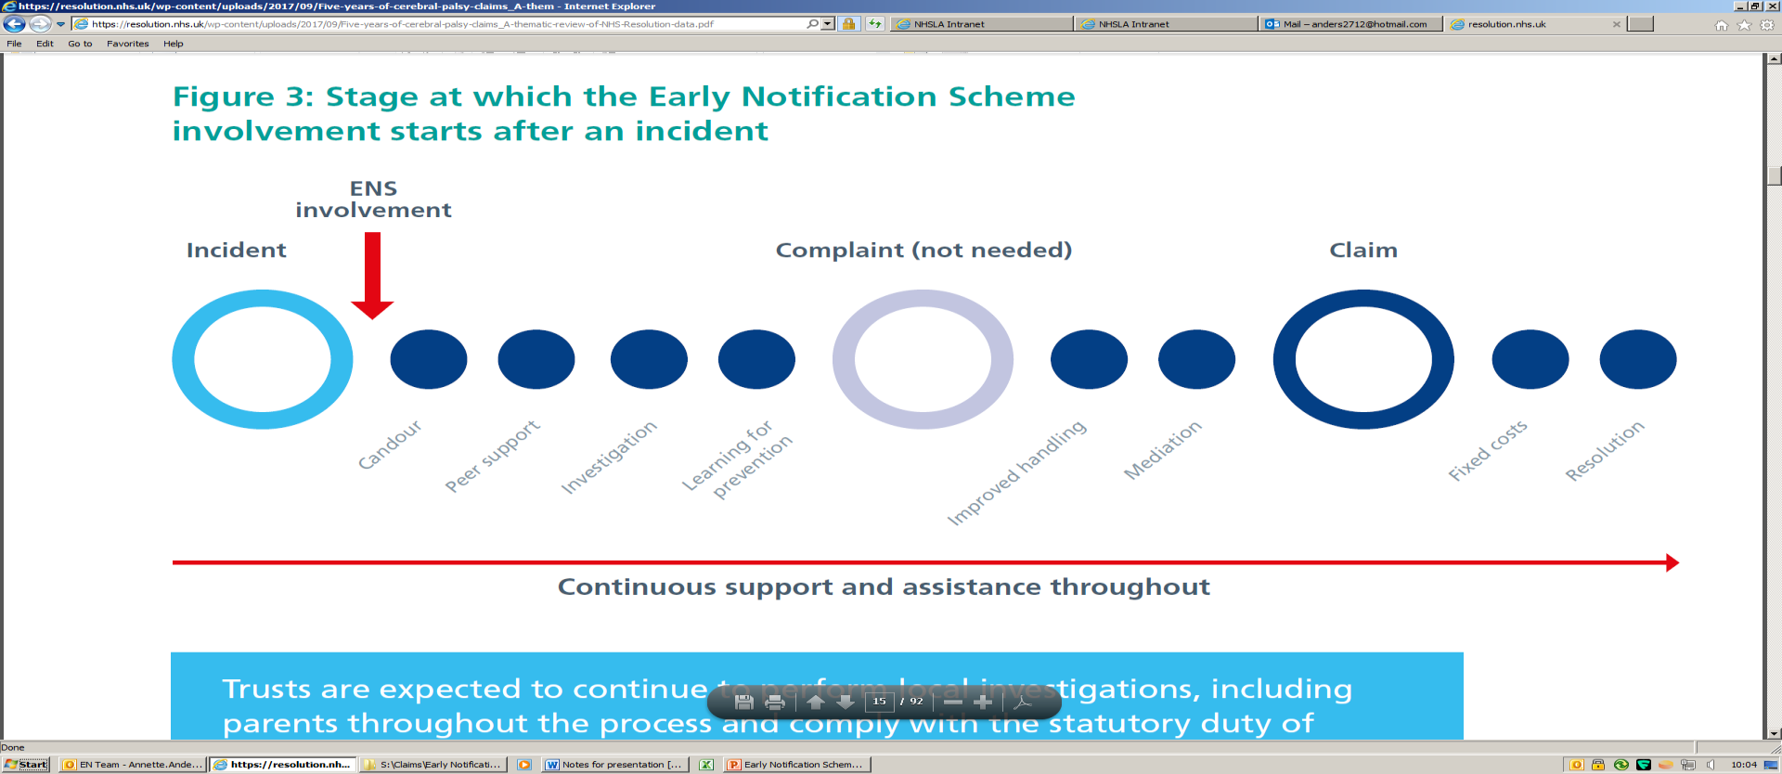
1. The Early Notification Scheme
Our role – getting closer to the incident
Before
Now
EN involvement

Slide 18
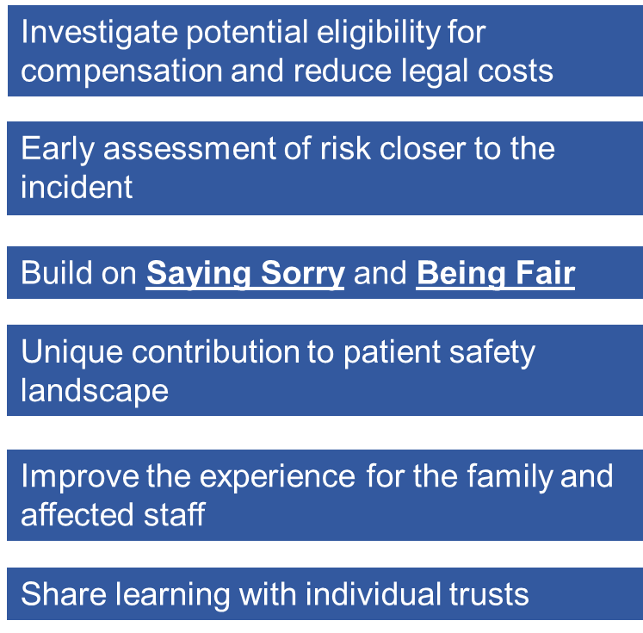
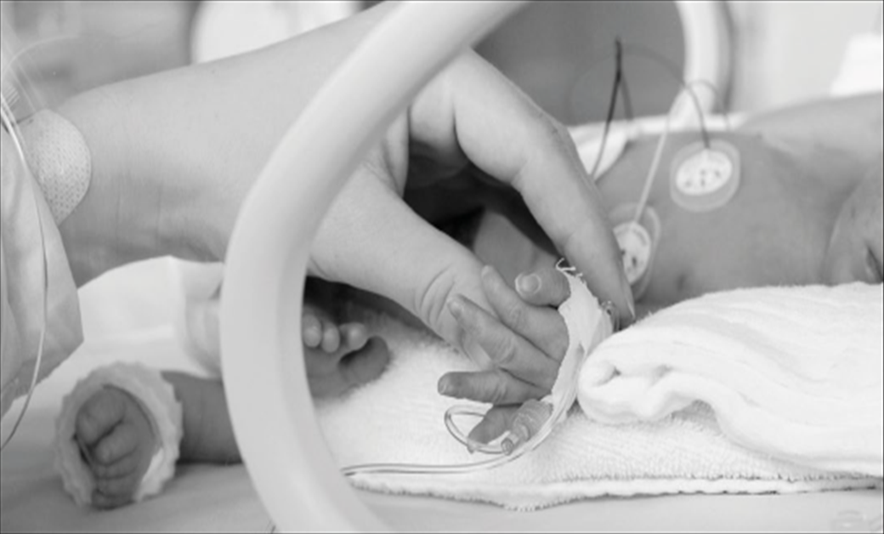
1. The Early Notification Scheme - aims and benefits

Slide 19
2. The Early Notification Scheme: criteria and liability investigation process

Slide 20
2. The Early Notification Scheme: clinical definition
Entry criteria is based on MNSI’s investigations for severe brain injury;
From 1 April 2021, EN triage and, where appropriate, clinically review according to the following clinical definition:
“Babies who have an abnormal MRI scan where there is evidence of changes in relation to intrapartum hypoxic ischaemic encephalopathy (HIE)”

Slide 21
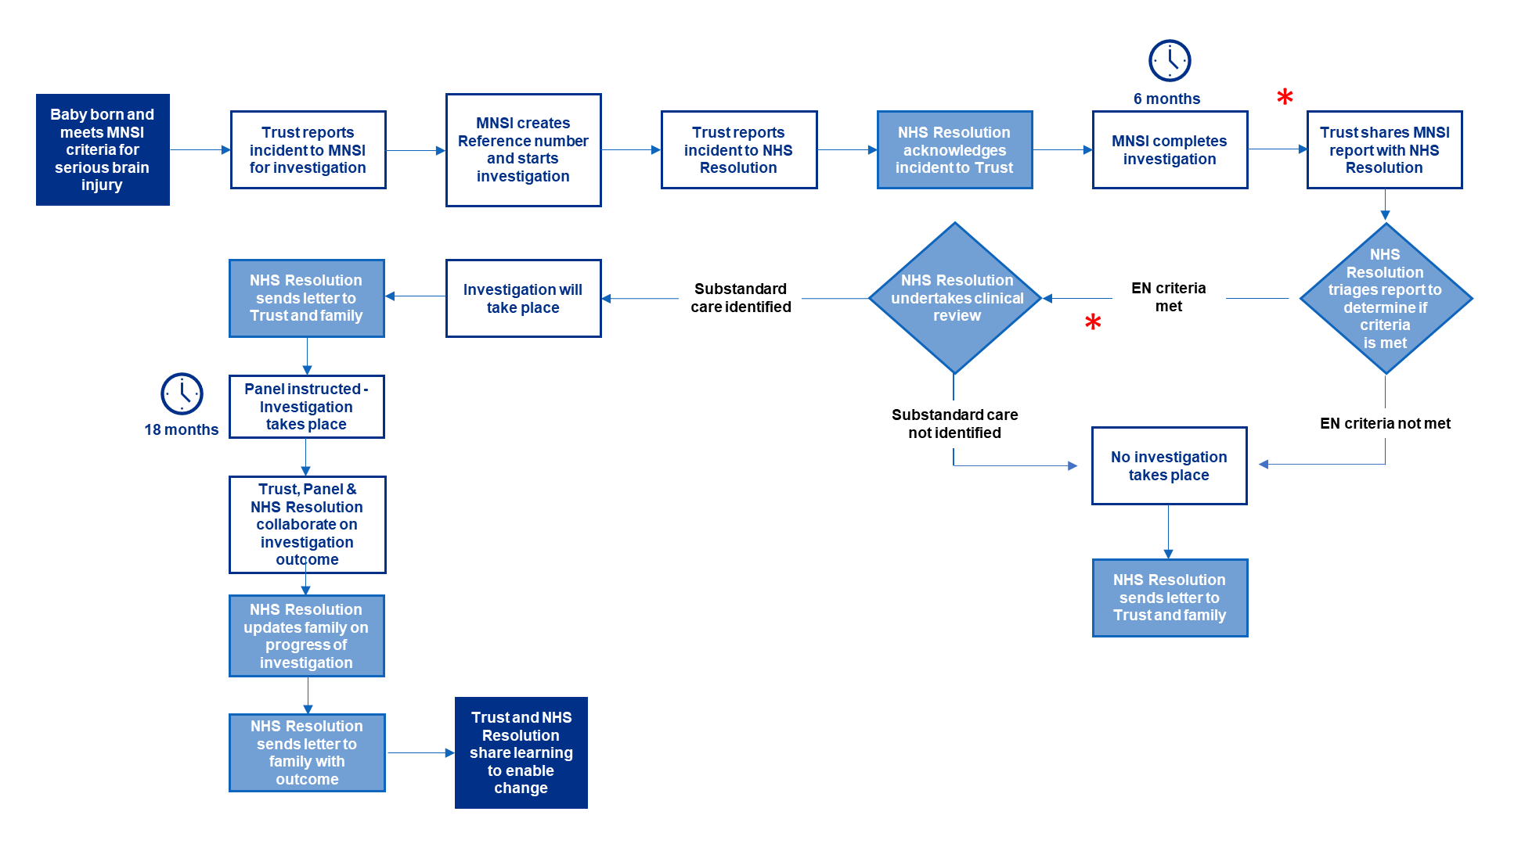
2. The Early Notification Scheme: investigation process

Slide 22

3. The Second EN Report
The evolution of the Early Notification Scheme

Slide 23
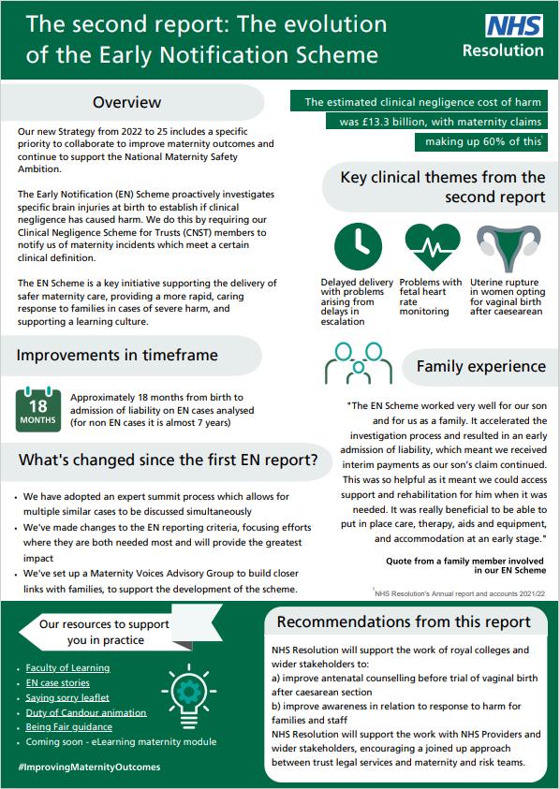
3. The Second EN Report

Slide 24
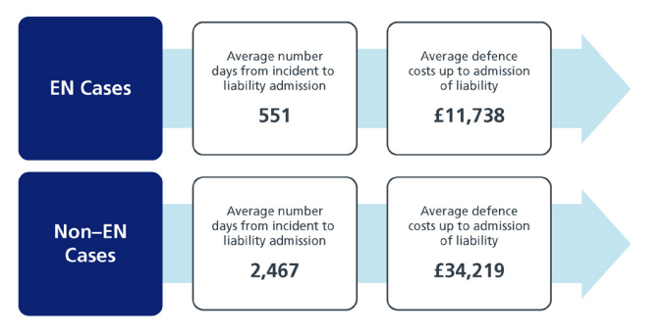
3. The Second EN Report
Chapter 2 – Benefits of early liability investigations

Slide 25
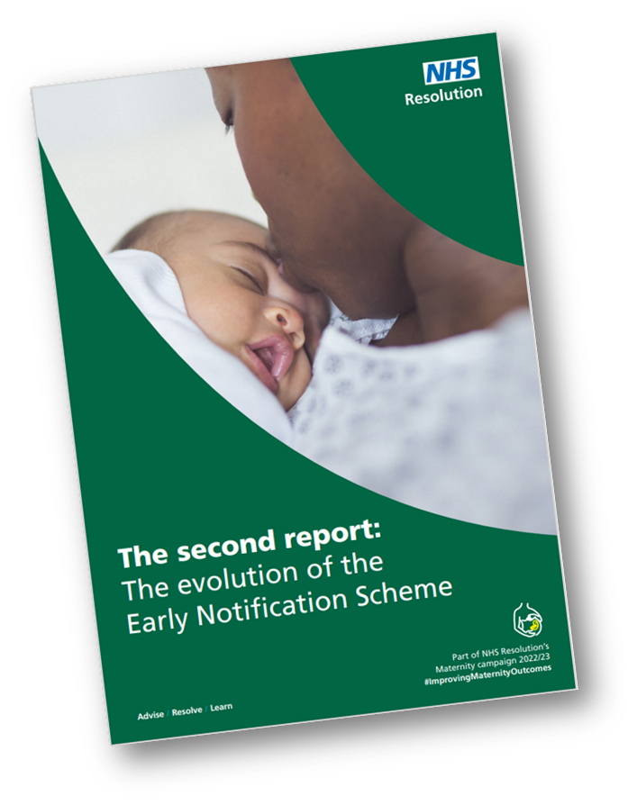
3. The Second EN Report
Chapter 5 – Evolution of the EN Scheme
  439 claims identified (01.04.17 to 31.03.22) including:
    admissions of breach of duty only;
    admissions of liability (breach of duty and causation); and
    letters of claims received in traditional sense or damages paid.
  New streamlined Liability Protocol (“Expert Summit” approach) - expedites provision of a high-quality response to families
  Illustrative Case Story
  Creation of Maternity Voices Advisory Group

Slide 26
3. The Second EN Report
Chapter 6 – Recommendations
1: Support the work to improve antenatal counselling before trial of vaginal birth after caesarean
2: Support the work to improve awareness in relation to response to harm for families and staff
3: Support working relationships and encourage a joined-up approach between trust legal services and maternity and risk teams

Slide 27

Supporting family experience and the work of the Maternity Voices Advisory Group
Elizabeth Pells RM
Early Notification Family Liaison and Mediation Lead
NHS Resolution

Slide 28
Early Notification Family Liaison and Mediation Lead
Work to ensure resources for families are in a format to meet their needs.
Developing a family needs assessment to best support communication with families.
Improving family awareness of the Early Notification Scheme.
Develop family facing resources on the NHS Resolution website.
Support work to improve the psychological support and training for our staff following challenging interactions.
Obtain family feedback and ensure this is used to inform the development of the Early Notification Scheme.

Slide 29

Maternity Voices Advisory Group
Aim is to provide external stakeholders, in particular families and their representatives, with a forum through which they could advise and support future service developments within the Early Notification scheme.
We are working on hearing the feedback from parents to support us in developing resources and information.

Slide 30


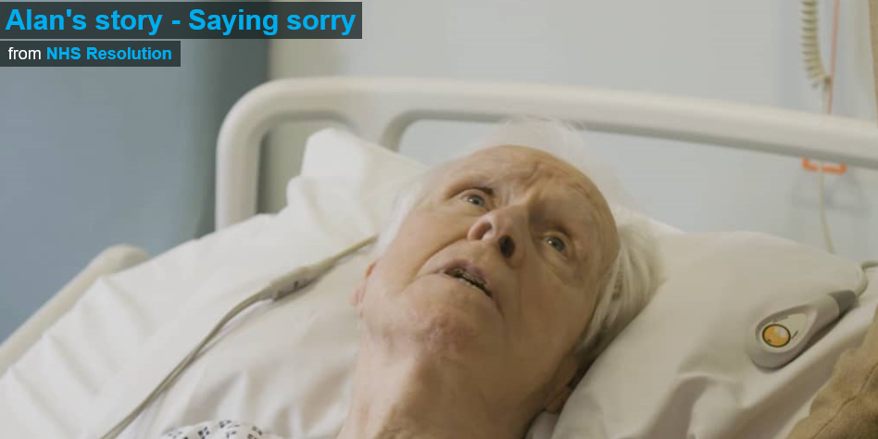



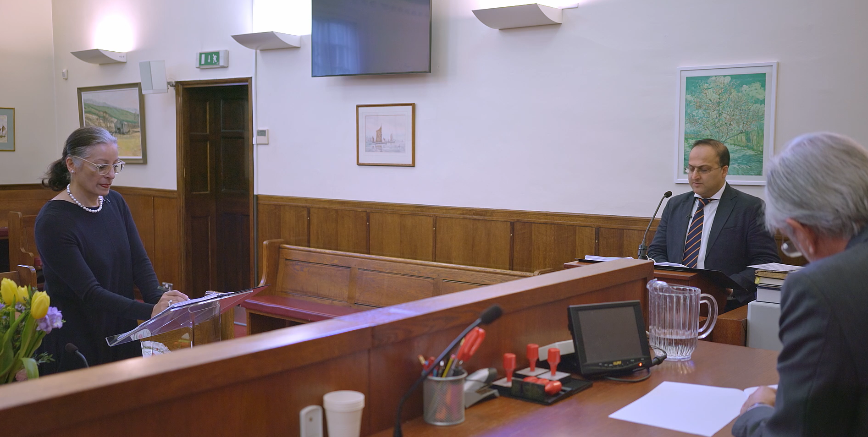





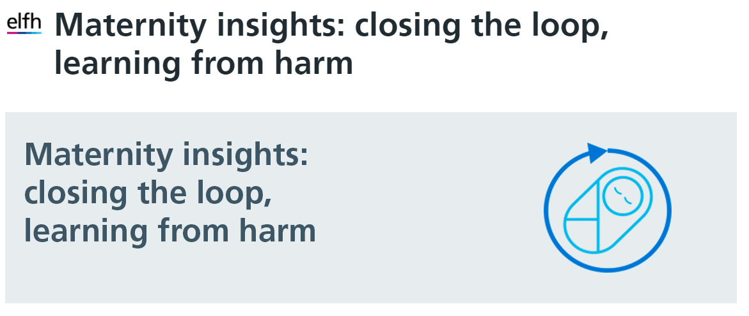
Sharing learning resources
https://resolution.nhs.uk/resources/

Slide 31





Find out more
If you do have any questions, please contact:
Sangita Bodalia, Head of Early Notification Team (Legal) s.bodalia@nhs.net
Jayne Poole, Safety and Learning Lead (Early Notification) Jayne.Poole6@nhs.net
Elizabeth Pells, Early Notification Family Liaison and Mediation Lead, elizabeth.pells@nhs.net
020 7811 2700
NHSResolution
www.resolution.nhs.uk

